Slide 1
PREDICTING HOUSE PRICES USING THE HOUSE PRICES- ADVANCED REGRESSION TECHNIQUES DATASET
CAPSTONE PROJECT 2023/24 - ALTSCHOOL DATA SCIENCE TINYUKA
ENE-OBONG DANIELLA
(13/08/2024)

Slide 2
PROBLEM STATEMENT
The Problem
When preparing a property for sale, determining the optimal pricing is a crucial step.
Inaccurate pricing leads to undervaluation or overestimation of the property value which in turn leads to huge financial losses on the part of the homeowner and he real estate agent entrusted with the sale.
The Objective
To develop a robust regression model that can accurately estimate house prices based on various property features. This project is a regression task that employs supervised learning for a data-driven approach to property value estimation.

Slide 3
DATASET OVERVIEW
Dataset
Kaggle House Prices - Advanced Regression Techniques
Size
81 attributes with 1460 observations
Data Types
Numeric (continuous eg LotFrontage, LotArea, etc and discrete eg OverallQual, OverallCond)
Categorical eg BsmtQual(Basement Quality), ExtQual(Exterior Quality), Functional(Home functionality)

Slide 4
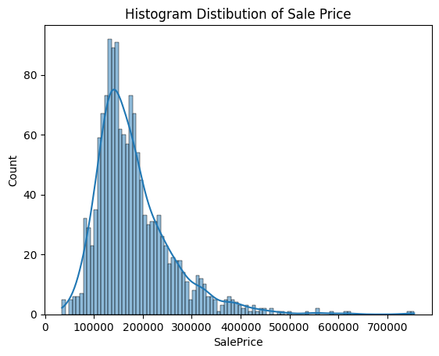
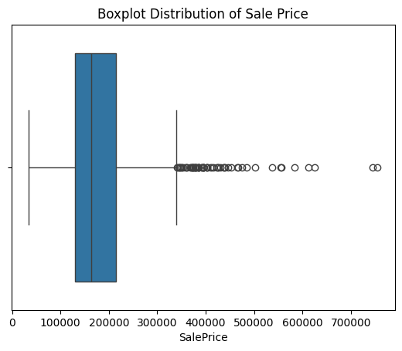
EXPLORATORY DATA ANALYSIS
House Prices are observed to be highly skewed to the left with a majority of houses selling between 100k and 200k while containing outliers with values as high as 700k.

Slide 5
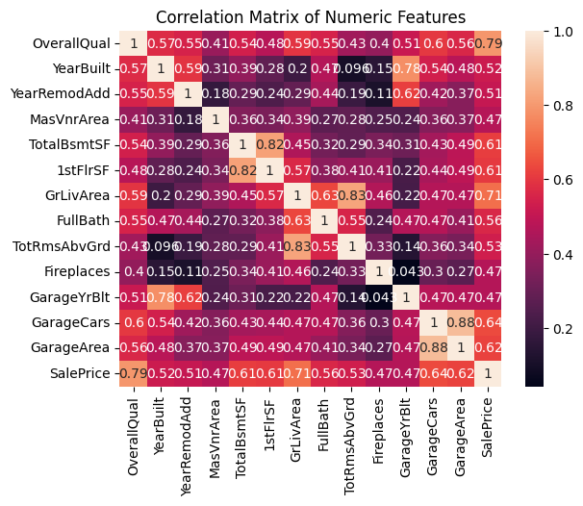
EXPLORATORY DATA ANALYSIS
Features such as the Overall Quality, Year Built, presence of a Ground Living Area and others are seen to have a high positive correlation with the Sale Price.
Whereas features like YearBuilt with GarageYearBuilt and Total Basement Square Footage with the Square Footage of the 1st Floor show high positive correlation with each other.

Slide 6
DATA CLEANING
Handling Missing Values
The missing values were handled by Median imputation for continuous numeric variables and replacing ‘NA’ values with ‘None’ for categorical variables as null categorical values indicated the absence of those features.
Outliers
Outliers having been detected graphically using boxplots were then treated by capping and flooring using inter-quartile thresholds.

Slide 7
FEATURE ENGINEERING
New Features
The Total Floor Square Footage and House Age were calculated from existing features along with the presence of a Garage as well as the Total Baths available.
Feature Scaling
Continuous numeric features were scaled using the sci-kit learn’s Standard Scaler while the ordinal categorical features were Label encoded and the nominal categorical features One-hot encoded.

Slide 8
MODEL SELECTION
Models Considered
Linear Regression, Decision Tree Regressor and the Random Forest Regressor.
Rationale
Linear regression as the baseline model, Decision Tree for capturing non-linear relationships and Random Forest for ensemble learning.
The preprocessed data was split into the training and validation set using sci-kit’s learn train_test_split in an 80:20 ratio and hyperparameter tuning performed on the selected Random Forest Regressor.

Slide 9
MODEL PERFORMANCE COMPARISON
The performance of the trained models was evaluated using the metrics MSE, RMSE and R-squared.
Model | MSE | RMSE | MAE | R-squared
Linear Regression | 294046.37 | 542.26 | 30494.83 | -79818915184.09
Decision Tree Regressor | 0.48 | 0.69 | 0.34 | 0.78
Random Forest Regressor | 0.31 | 0.56 | 0.23 | 0.91
The random forest model demonstrates the best performance among the evaluated models, with a significantly lower RMSE and higher R-squared value. This indicates its ability to capture complex relationships and generalise well to unseen data.

Slide 10
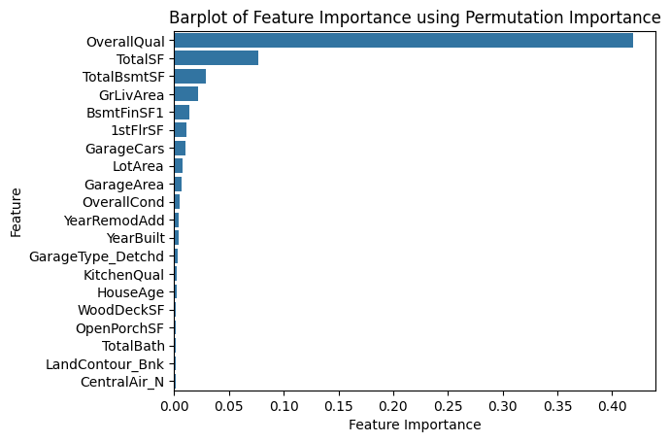
MODEL INSIGHTS
Empirically, we can ascertain that the Overall Quality of a house would be a key determinant of the price of a house and going further, our personal decision to make the purchase.
This bar plot shows the importance features like the Overall Quality, Total Square Feet (which was engineered) and Overall Condition had on the performance of the model.
Hence, the developed model can be used by real estate agents and homeowners to estimate property values more accurately.

Slide 11
CONCLUSION, LIMITATIONS AND FUTURE WORK
Conclusion
The Random Forest model effectively predicts house prices, outperforming other models. Key factors influencing price include overall quality, living area, and neighborhood. This model offers valuable insights for real estate professionals.
Limitations
Model limitations include reliance on dataset quality and potential overfitting. External factors can impact accuracy.
Future Work
To improve the model, consider incorporating additional features, exploring advanced algorithms, and addressing potential biases in the data.

